Slide 1
APTITUDE
DATA INTERPRETATION
(TABLE FORM TYPE)

Slide 2
APTITUDE
In the tabular method, data is arranged in vertical and horizontal rows. It is the easiest way of representing data but not the easiest way of interpreting data.

Slide 3
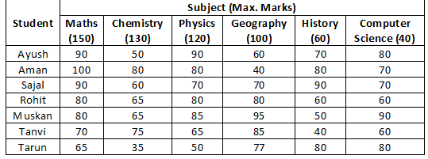
APTITUDE
DATA INTERPRETATION
Direction(1--5): The following table gives the percentage of marks obtained by seven students in six different subjects in an examination.
The Numbers in the Brackets give the Maximum Marks in Each Subject.

Slide 4
APTITUDE
DATA INTERPRETATION
Q:1. What are the average marks obtained by all the seven students in Physics? (rounded off to two digit after decimal)
77.26 B) 89.14 C) 91.37 D) 96.11
Q:2. The number of students who obtained 60% and above marks in all subjects is?
1 B) 2 C) 3 D) None
Q:3. What was the aggregate of marks obtained by Sajal in all the six subjects?
409 B) 419 C) 429 D) 449
Q:4. In which subject is the overall percentage the best?
Maths B) Chemistry C) Physics D) History
Q:5. What is the overall percentage of Tarun?
52.5% B) 55% C) 60% D) 63%

Slide 5
APTITUDE
DATA INTERPRETATION
Q:1. What are the average marks obtained by all the seven students in Physics? (rounded off to two digit after decimal)
77.26 B) 89.14 C) 91.37 D) 96.11
Q:2. The number of students who obtained 60% and above marks in all subjects is?
1 B) 2 C) 3 D) None
Q:3. What was the aggregate of marks obtained by Sajal in all the six subjects?
409 B) 419 C) 429 D) 449
Q:4. In which subject is the overall percentage the best?
Maths B) Chemistry C) Physics D) History
Q:5. What is the overall percentage of Tarun?
52.5% B) 55% C) 60% D) 63%

Slide 6
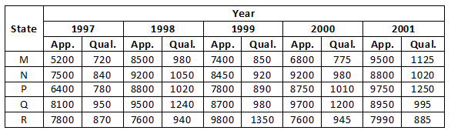
APTITUDE
DATA INTERPRETATION
Direction(6-10): Study the following table and answer the questions.
Number of Candidates Appeared and Qualified in a Competitive Examination from Different States over the Years.

Slide 7
APTITUDE
DATA INTERPRETATION
Q:6. Total number of candidates qualified from all the states together in 1997 is approximately what percentage of the total number of candidates qualified from all the states together in 1998?
72% B) 77% C) 80% D) 83
Q:7. What is the average candidates who appeared from State Q during the given years?
8700 B) 8760 C) 8990 D) 8920
Q:8. In which of the given years the number of candidates appeared from State P has maximum percentage of qualified candidates?
1997 B) 1998 C) 1999 D) 2001
Q:9. What is the percentage of candidates qualified from State N for all the years together, over the candidates appeared from State N during all the years together?
12.36% B) 12.16% C) 11.47% D) 11.15%
Q:10. The percentage of total number of qualified candidates to the total number of appeared candidates among all the five states in 1999 is?
11.49% B) 11.84% C) 12.21% D) 12.57%

Slide 8
APTITUDE
DATA INTERPRETATION
Q:6. Total number of candidates qualified from all the states together in 1997 is approximately what percentage of the total number of candidates qualified from all the states together in 1998?
72% B) 77% C) 80% D) 83
Q:7. What is the average candidates who appeared from State Q during the given years?
8700 B) 8760 C) 8990 D) 8920
Q:8. In which of the given years the number of candidates appeared from State P has maximum percentage of qualified candidates?
1997 B) 1998 C) 1999 D) 2001
Q:9. What is the percentage of candidates qualified from State N for all the years together, over the candidates appeared from State N during all the years together?
12.36% B) 12.16% C) 11.47% D) 11.15%
Q:10. The percentage of total number of qualified candidates to the total number of appeared candidates among all the five states in 1999 is?
11.49% B) 11.84% C) 12.21% D) 12.57%

Slide 9
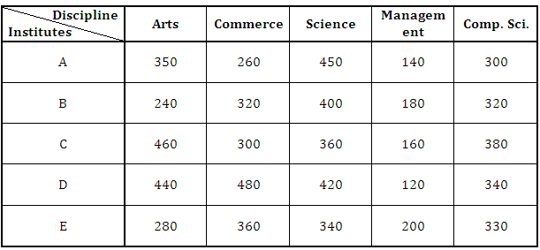
APTITUDE
DATA INTERPRETATION
Direction(11--14): Study the following table carefully to answer the following questions.
Number of students studying in five different disciplines from five Institutes

Slide 10
APTITUDE
DATA INTERPRETATION
Q:11. What is the average number of students studying Commerce from all the Institutes together?
356 B) 360 C) 348 D) 344 E) None of these
Q:12.The total number of students studying Arts from Institutes A and B together is approximately what percent of the total number of students studying Computer Science from these two Institutes?
84 B) 85 C) 88 D) 90 E) 95
Q:13.The number of students studying Commerce from Institute D is what percent of the total number of students studying all the disciplines together from the same Institute?
28 B) 23.23 C) 35.35 D) 30 E) None of these
Q:14.What is the ratio between the total number of students studying Science from Institutes C and D together and the total number of students studying computer Science from these two Institutes together respectively?
13: 12 B) 12: 13 C) 13: 15 D) 15: 13 E) None of these

Slide 11
APTITUDE
DATA INTERPRETATION
Q:11. What is the average number of students studying Commerce from all the Institutes together?
356 B) 360 C) 348 D) 344 E) None of these
Q:12.The total number of students studying Arts from Institutes A and B together is approximately what percent of the total number of students studying Computer Science from these two Institutes?
84 B) 85 C) 88 D) 90 E) 95
Q:13.The number of students studying Commerce from Institute D is what percent of the total number of students studying all the disciplines together from the same Institute?
28 B) 23.23 C) 35.35 D) 30 E) None of these
Q:14.What is the ratio between the total number of students studying Science from Institutes C and D together and the total number of students studying computer Science from these two Institutes together respectively?
13: 12 B) 12: 13 C) 13: 15 D) 15: 13 E) None of these

Slide 12
APTITUDE
THANK YOU

